Slide 1


WELCOME

Slide 2
Department of Computer Science and Engineering
Sleep Disorder:Sleep Disorder Detection Using Deep Learning
And Genetic Algorithm Optimization
PRESENTED BY
B. Sarath Chandra (23475A0510)
K,Sai manikanta (22471A05O8)
Under the Guidance of,
M.Suresh _{M.Tech,}
Assistant professor
Department of Computer Science and Engineering,
Narasaraopeta Engineering College (Autonomous),
Narasaraopet- 522 601.

Slide 3
OUTLINE
Abstract
Introduction
Literature Survey
Research Gaps
Problem Statement
Objectives
Block Diagram / Flow Diagram
Methodology
Implementation
Results and Analysis
Conclusion & Future Scope
References
Acknowledgements
Question and Answers

Slide 4
ABSTRACT
This project focuses on automated detection of sleep disorders such as Sleep Apnea and Insomnia using Deep Learning and Genetic Algorithm (GA) optimization.
The study uses the Sleep Health and Lifestyle Dataset with 400 records and 13 attributes.
Data preprocessing includes label encoding, feature scaling, and blood pressure transformation.
Three models—Artificial Neural Network (ANN), Random Forest, and XGBoost—were evaluated
The ANN achieved the highest accuracy (94.17%), demonstrating the potential of deep learning for healthcare diagnostics
These findings highlight the role of deep models in accurate, scalable, and automated sleep disorder detection systems.

Slide 5
INTRODUCTION
Sleep disorders negatively impact daily functioning, cognition, and overall health.
Traditional diagnostic methods are manual, slow, and inconsistent.
Machine Learning and Deep Learning offer automated, real-time diagnosis to assist healthcare professionals.
The project leverages data-driven analysis to classify sleep disorders efficiently.
Motivation: To enhance diagnostic accuracy and reduce dependency on manual interpretation.
Relevance: Supports AI-based healthcare systems and wearable device integration for real-time monitoring

Slide 6
LITERATURE SURVEY
No | Title | Author | Journal Name & Year | Methodology Adapted | Key Findings | Gaps
6 | New Oversampling Approaches Based on Polynomial Fitting | Sami Gazzah & Najoua E.B. Amara, | 2008, IEEE DAS | Curve-fitting in feature space | Improves True Positive Rate using writer-style curves. | Evaluation limited to handwriting dataset; no deep model testing
7 | SMOTE: Synthetic Minority Over-sampling Technique | N.V. Chawla et al., | 2002, IEEE AI Review | KNN-based sample interpolation. | Introduced synthetic sample creation to address imbalance | Introduced synthetic sample creation to address imbalance
8 | FullSleepNet: A Fully Convolutional Multi-Task Network for Arousal Detection and Sleep Stage Classification | Zan & Yildiz, arXiv | 2024,IEEE | EEG normalization, temporal windowing, feature scaling | Combined arousal and stage classification in one model; achieved 88% accuracy and 0.70 AUPRC | Requires large labeled EEG datasets high computational cost

Slide 7
LITERATURE SURVEY
No | Title | Author | Journal Name & Year | Methodology Adapted | Key Findings | Gaps
1 | RB-CCR: Radial-Based Combined Cleaning and Resampling Algorithm | Michał Koziarski et al., 2021, IEEE DSAA | 2021, IEEE DSAA | Energy-based instance cleaning, Class potential estimation using Radial Basis Function | Class potential used to guide oversampling; achieves better G-mean & AUC than CCR | Region selection needs cross-validation; no explicit noise handling
2 | Synthetic Oversampling for Twitter Imbalanced Sentiment Analysis | ules Ah-Pine and Edwin- Piero Soriano-Morales, | 2019, Published in the 2019 International Conference on Data | Standard NLP text cleaning (tokenization, lowercasing); class balancing via synthetic oversampling techniques | Compared SMOTE, ADASYN, and Borderline- SMOTE on Twitter datasets; ADASYN gave more stable results. | Limited to 3 datasets and traditional classifiers; doesn’t explore deep learning models or real-time

Slide 8
LITERATURE SURVEY
No | Title | Author | Journal Name & Year | Methodology Adapted | Key Findings | Gaps
3 | Handling Imbalanced Datasets by Partially Guided Hybrid Sampling | Tushar Sandhan, Jin Young Choi, | 2014, IEEE ICPR | Feature space projection, PCA & Kernel PCA | Introduces guided oversampling; improves minority retention | High complexity; not tested in online settings.
4 | Over-Sampling Based on Data Density & Cost- Sensitive SVM | Qinghua Cao et al., 2011, IEEE ICIII | 2011, IEEE ICIII | OPTICS-based density estimation, noise filtering | SMOBD uses density to avoid noisy samples; outperforms SMOTE | Density tuning is dataset- specific
5 | Data Imbalance Problem in Text Classification | Yanling Li et al., | 2010, IEEE Info. Processing | Word length, word frequency, class size balancing | Class size and word count directly affect accuracy. | Doesn’t suggest balancing techniques; dataset domain-specific

Slide 9
LITERATURE SURVEY
No | Title | Author | Journal Name & Year | Methodology Adapted | Key Findings | Gaps
9 | SleepLiteCNN: Energy-Efficient Sleep Apnea Subtype Classification Using Single-Lead EC | Mohammadi & Mohammadi, arXiv | 2025,IEEE | ECG filteration, normalization, quantization | 95% accuracy with 92% F1-score; efficient for wearable systems | Tested on limited ECG data; lacks multimodal input
10 | Multimodal Vision Transformer for Sleep Stage and Apnea Detection | Kazemi et al | .2025, arXiv | Signal segmentation, feature fusion, scaling | Accuracy of 78% (staging) and 74% (apnea detection); model interpretability through attention weights | Requires multiple sensor inputs; complex deployment

Slide 10
RESEARCH GAPS
Limited datasets with small sample sizes restrict model generalization.
Most prior works focus on specific modalities (EEG, ECG) rather than lifestyle-based analysis.
Few models emphasize real-time implementation or integration with wearable devices.
Optimization techniques like Genetic Algorithms are underexplored for sleep data improvement.

Slide 11
PROBLEM STATEMENT
Sleep disorders like Insomnia and Sleep Apnea significantly affect health, performance, and quality of life.
Traditional diagnostic methods such as polysomnography are manual, expensive, and time-consuming, requiring specialized sleep labs and expert interpretation.
There is a lack of accessible and automated systems capable of detecting sleep disorders using easily available health and lifestyle parameters.
The project aims to develop a Deep Learning–based automated framework that classifies sleep disorders accurately from lifestyle and physiological data.
To further enhance model performance, a Genetic Algorithm (GA) is used for hyperparameter optimization and to improve accuracy and generalization.

Slide 12
OBJECTIVES
Implement ANN, Random Forest, and XGBoost for sleep disorder classification.
Apply Genetic Algorithm optimization to improve model accuracy.
Perform data preprocessing and feature transformation.
Compare and evaluate models using metrics like Accuracy, Precision, Recall, F1-score.
Develop a framework that supports scalable healthcare automation.

Slide 13
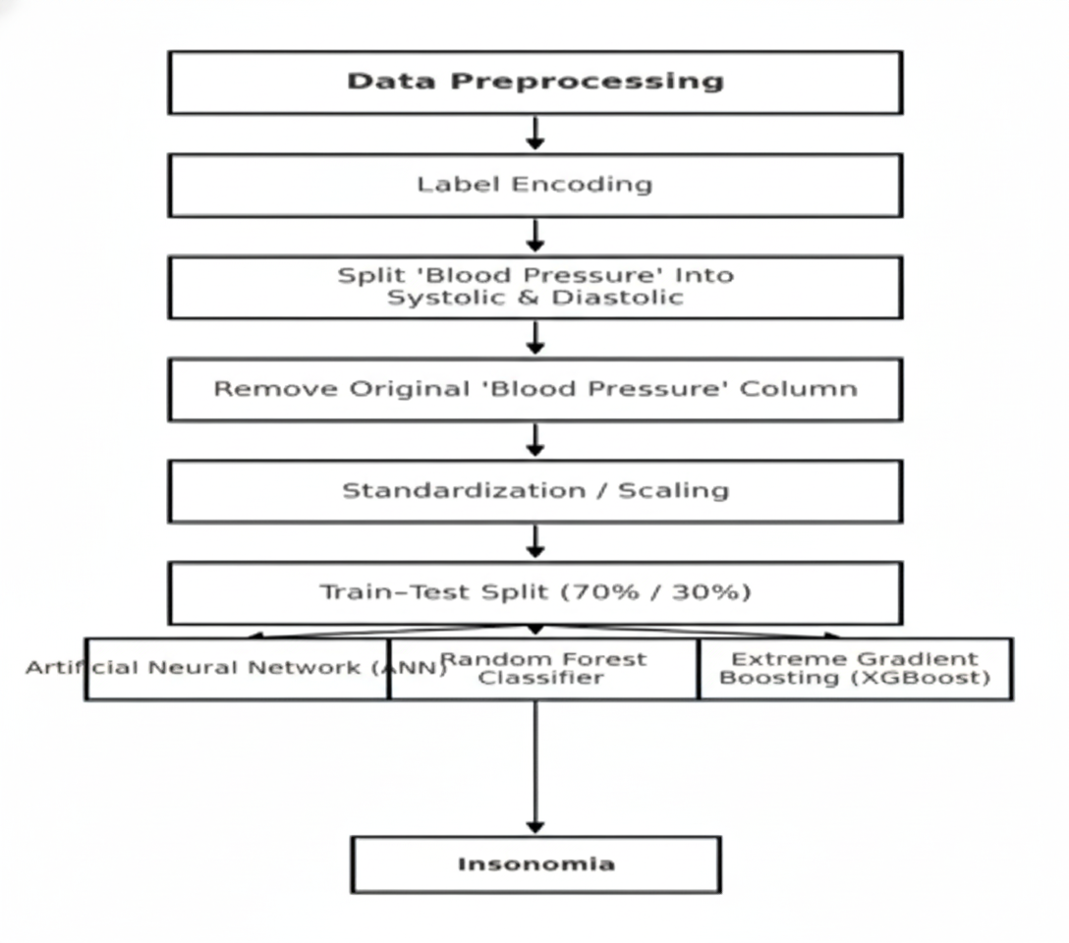
BLOCK DIAGRAM OR FLOW DIAGRAM

Slide 14
METHODOLOGY
Pre-Processing
Step 1: Data Collection
Dataset: Sleep Health and Lifestyle Dataset (400 records, 13 attributes) from Kaggle.
Includes demographic, lifestyle, and physiological features like sleep duration, stress level, and blood pressure.
Step 2: Data Preprocessing
Label encoding for categorical attributes (Gender, Occupation, BMI Category, Sleep Disorder).
Split “Blood Pressure” into Systolic and Diastolic values.
Normalization using StandardScaler to ensure uniform scaling.
Dataset divided into 70% training and 30% testing subsets.

Slide 15
METHODOLOGY
Pre-Processing
Step 3: Model Development
Implemented three models:
  Artificial Neural Network (ANN)
  Random Forest Classifier
  XGBoost Classifier
Step 4: Optimization
Used Genetic Algorithm (GA) for hyperparameter tuning to improve ANN accuracy and prevent overfitting.
Step 5: Evaluation
Metrics: Accuracy, Precision, Recall, F1-score, and Confusion Matrix.
Compared results across all models to determine the most efficient classifier.

Slide 16
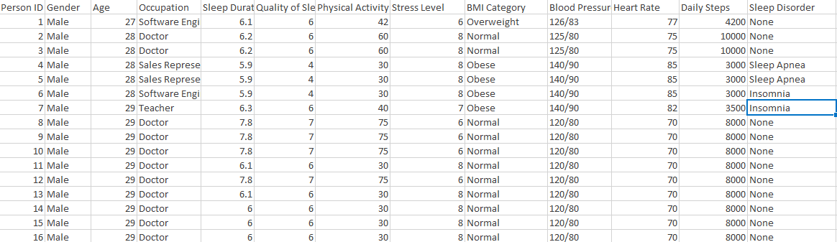
METHODOLOGY
Sample Data From The Dataset

Slide 17
Framework:- Artificial Neural Network(ANN)
Why Artificial Neural Network (ANN)?
ANN mimics the structure and learning process of the human brain, making it highly suitable for pattern recognition tasks such as sleep disorder detection.
Capable of modeling non-linear relationships between multiple health and lifestyle features.
Layer(Type) | Output Shape | Param #
dense (Dense) | (None,128) | 1,792
dropout (Dropout) | (None, 128) | 0
dense_1 (Dense) | (None, 64) | 8,256
Dropout_1 (Dropout) | (None, 64) | 0
dense_2(Dense) | (None, 32) | 2,080
Softmax(xᵢ) = exp(xᵢ)
y=f(i=1∑n​wi​xi​+b)
ReLU(x) = max(0, x)

Slide 18
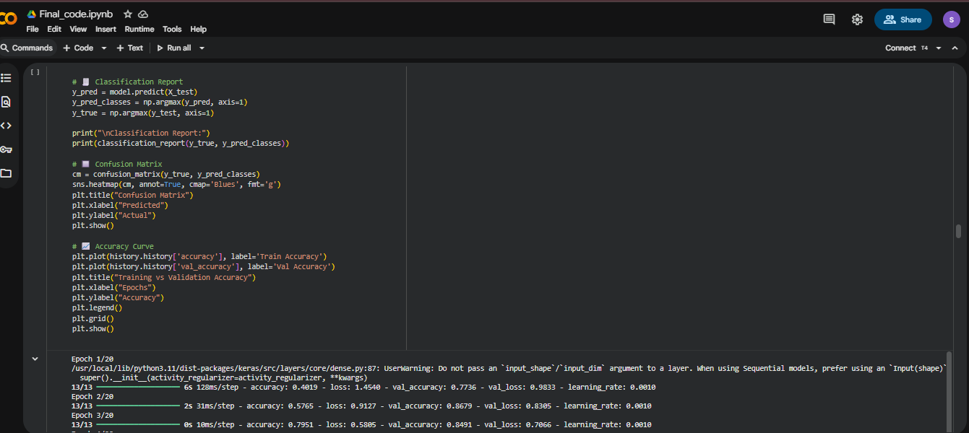
Implementation

Slide 19
System Requirements
Hardware Requirements
Processor : intel Core i3
Cache memory : 4MB(Megabyte)
RAM : 12.7GB (gigabyte)
Hard Disk : 166.8GB
Compute Engine : T4 GPU
Software Requirements
Operating System : Windows 10, 64-bit Operating System
Coding Language : Python
Python distribution : Google Colab Pro , Flask
Browser : Any Latest Browser like Chrome

Slide 20
Challenges Vs Overcomes
Challenges Faced | Solutions Implemented
Overfitting Due to Small Dataset – Limited data (400 records) led to high training accuracy but poor generalization. | Regularization & Dropout Layers – Added dropout layers in ANN and applied early stopping to prevent overfitting
Limited Computational Resources – Deep learning models required high processing power for optimization and tuning. | GPU Utilization (Google Colab T4) – Leveraged GPU-accelerated training to significantly reduce computation time.
Class Imbalance in Sleep Disorder Categories – Fewer records for Insomnia and Sleep Apnea compared to “None.” | Class Balancing – Applied class weighting and oversampling techniques to maintain equal representation during training
Data Variability and Noise – Lifestyle features like stress, occupation, and sleep duration had subjective variance. | Feature Normalization – Used StandardScaler for consistent feature scaling and cleaned outliers for stable learning.
Model Interpretability – Deep learning models lacked explainability for medical understanding. | Evaluation Metrics and Confusion Matrix – Provided clear performance reports and class-level analysis for better interpretability.

Slide 21
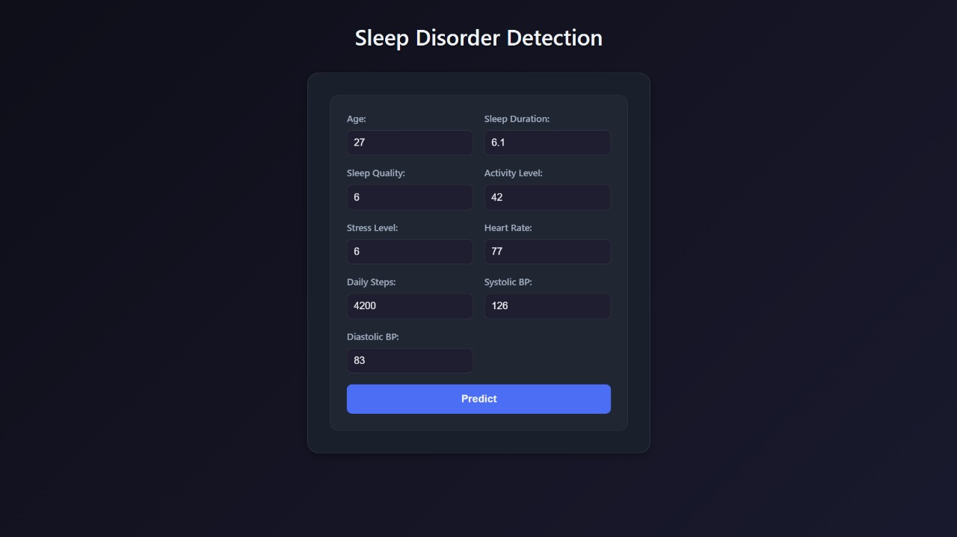
Implementation of Frontend

Slide 22
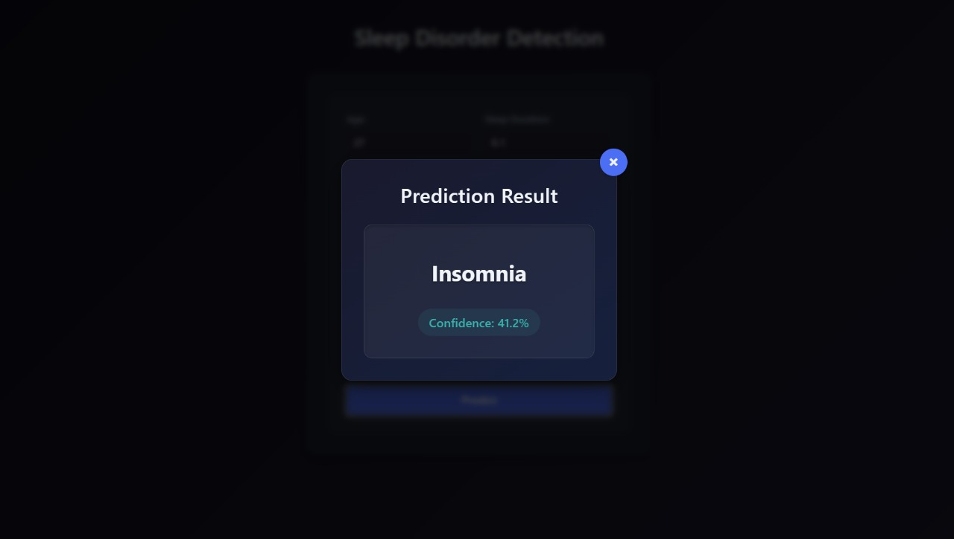
Implementation of Frontend

Slide 23
RESULTS & ANALYSIS
Model | Accuracy | Precision | Recall | F1-Score
Artificial Neural Network (ANN) | 94.17 | 94.0 | 93.5 | 93.7
XGBoost Classifier | 92.50 | 92.0 | 91.8 | 91.9
Random Forest Classifier | 91.67 | 91.0 | 90.6 | 90.8
The ANN model achieved the highest performance across all metrics — showing superior ability to capture complex non-linear relationships.XGBoost and Random Forest also performed well, with consistent results and high reliability.The balanced precision and recall values indicate that the model is not biased toward any one class.

Slide 24
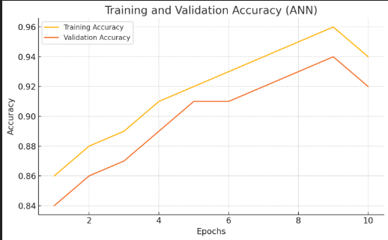
RESULTS & ANALYSIS
The graph shows that the training and validation accuracies of the ANN model rise steadily, reaching around 94% by 10 epochs.
The close alignment of both curves indicates goodgeneralization without overfitting.

Slide 25
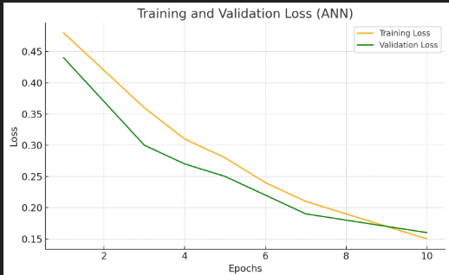
RESULTS & ANALYSIS
The graph shows a continuous reduction in both training and validation losses over epochs.
Both curves converge near 0.15, demonstrating stable model convergence.
Validation loss is consistently lower than training loss a strong indicator of good generalization.

Slide 26
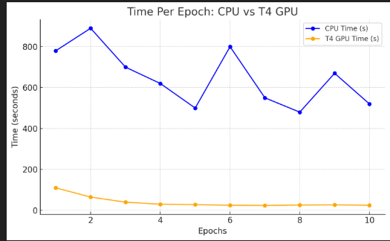
RESULTS & ANALYSIS
The graph shows that the T4 GPU significantly reduces training time per epoch compared to the CPU, enabling faster model development and testing.
GPU acceleration enhances overall efficiency, especially during hyperparameter tuning using Genetic Algorithm optimization.

Slide 27
CONCLUSION & FUTURE SCOPE
Conclusion:
ANN model outperformed traditional classifiers.
Demonstrated efficiency of GA-optimized deep learning in healthcare analytics.
Supports real-time, automated diagnosis of sleep disorders.
Future Scope:
Integration with EEG and PSG signals for improved accuracy.
Deployment on wearable devices for continuous monitoring.
Incorporate explainable AI (SHAP/LIME) for better interpretability.
Real-time implementation in telemedicine systems.

Slide 28
REFERENCES
Y. Zan and O. Yildiz, “FullSleepNet: A Fully Convolutional Multi-Task Network for Arousal Detection and Sleep Stage Classification,” arXiv preprint arXiv:2406.01834, 2024.
Proposed CNN-based model for both arousal and sleep stage detection using EEG signals.
M. Mohammadi and H. Mohammadi, “SleepLiteCNN: Energy-Efficient Sleep Apnea Subtype Classification Using Single-Lead ECG,” arXiv preprint arXiv:2508.02718, 2025.
Introduced lightweight CNN architecture for wearable devices.
J. Papillon et al., “Sleep Position Classification Using Transfer Learning with Vision Transformers,” arXiv preprint arXiv:2505.08111, 2025.
Demonstrated improved performance for non-intrusive sleep monitoring using ViT models.
S. Kazemi et al., “Multimodal Vision Transformer for Sleep Stage and Apnea Detection,” arXiv preprint arXiv:2502.17486, 2025.
Used multimodal data (PPG, respiration) for explainable sleep disorder detection.
M. Monowar et al., “Multi-Layered Ensemble Learning with Data Balancing for Sleep Disorder Detection,” Frontiers in Artificial Intelligence, vol. 7, p. 1506770, 2024.
Achieved 99.5% accuracy using data balancing and ensemble methods.
T. Chen and C. Guestrin, “XGBoost: A Scalable Tree Boosting System,” Proceedings of the 22nd ACM SIGKDD International Conference on Knowledge Discovery and Data Mining, pp. 785–794, 2016.

Slide 29
ACKNOWLEDGEMENTS
We would like to express our sincere gratitude to the faculty and staff of Narasaraopeta Engineering College for their guidance and encouragement throughout the development of this project. Their insights and expertise have been invaluable.
We also extend our thanks to the administration for providing the necessary resources and a platform to showcase our work. This opportunity has been instrumental in enhancing our learning and growth.
For any questions or further discussions, feel free to reach out:-
Email: beesabattunisarathchandra@gmail.com
Phone: 7013567316
Email:saimanikanta723@gmail.com
Phone:80085 18337

Slide 30
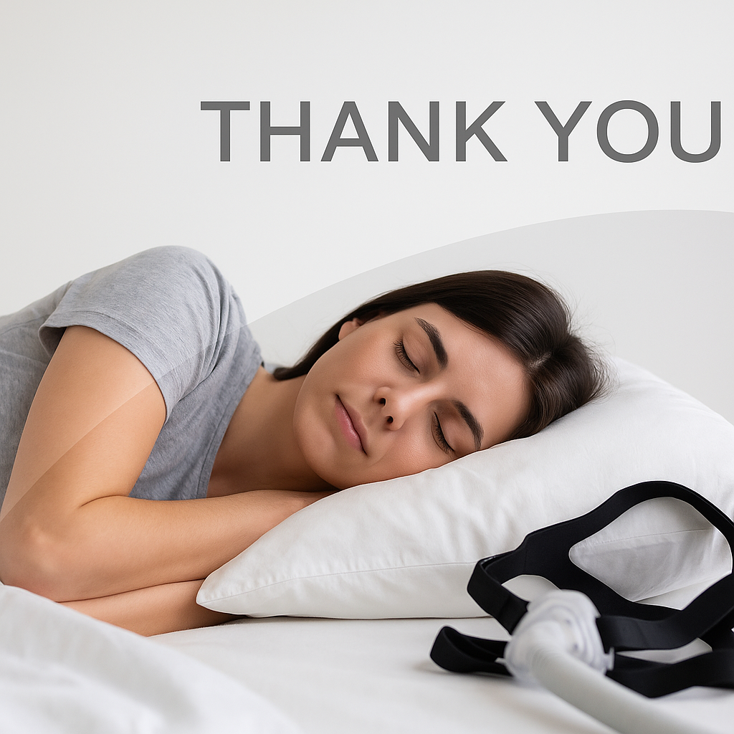

Slide 31


